Slide 1
Normalization Forms
Database Normalization: From Flat File to 3NF Subtitle: Step-by-Step Normalization Process

Slide 2
Client Asking you to convert Flat file data/table to 1NF, 2Nf, 3NF

Slide 3
Customer name | Customer post code | Customer contact details (phone) | Stock name | Product name | Numbers of item ordered | Numbers of item left in stock
Jake | SO155UP | 0775252362 | Southampton | Pomegranate Lime strawberry | 1 2 5 | 99 18 95
James | SO169OP | 0775523256 | Southampton | Lime Ice Cream Butter | 1 2 1 | 17 8 29
Roman | SO188IK | 0775252362 | Southampton | Candy Lime strawberry | 2 1 2 | 18 16 93
Andy | PO156YH | 0775252362 | Portsmouth | Ice Cream | 5 | 3
Karen | PO127YJ | 0775252362 | Portsmouth | Strawberry apple | 2 3 | 91 27

Slide 4
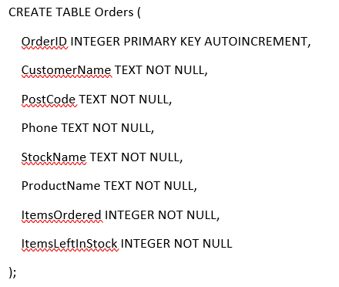
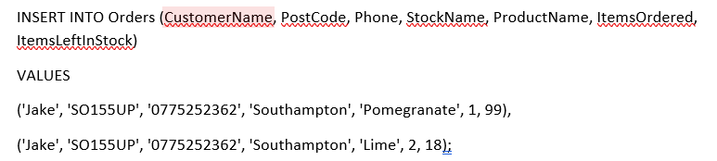
Convert to 1NF
Conversion to 1NF (First Normal Form) Title: Step 1 –
Achieving 1NF
To meet 1NF, we ensured:
Atomicity (each field contains only a single value).
Each product is stored in a separate row.
Insert data:

Slide 5
Convert to 2NF
Conversion to 2NF (Second Normal Form) Title: Step 2 - Achieving 2NF
Issue in 1NF:
Customer details were repeated in multiple rows.
Product details were stored redundantly.
Solution:
Created separate tables for Customers and Products.
Orders table now only references Customer and Product IDs.

Slide 6
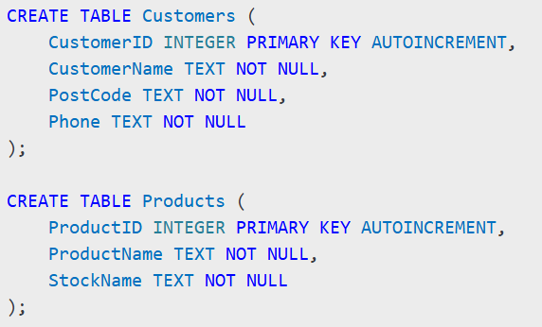
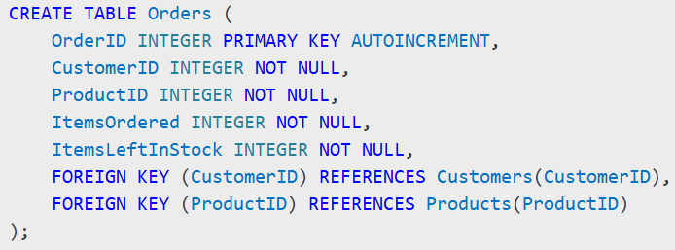
Convert to 2NF
2NF Table Structure:

Slide 7
Convert to 3NF
Issue in 2NF: StockName depended on ProductName.
Solution:
Moved Stock information to a separate table.
Product table references Stock table.

Slide 8
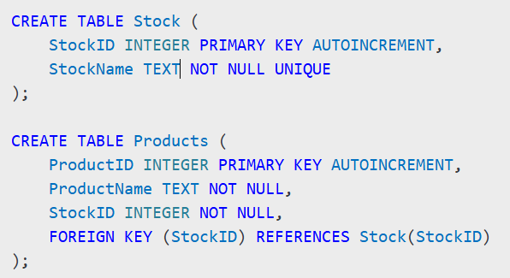
Convert to 3NF
Final 3NF Table Structure:

Slide 9
Create SQL Database with 3NF
Additional SQL Features
Included Features:
CRUD Operations: Select, Insert, Delete, Update.
Indexes for faster query performance.
Foreign Keys for data integrity.
Triggers (if required).
Views for easier data access.

Slide 10
Have you included any of : Summary & Conclusion Summary & Final Thoughts 🔹 We converted the flat file into a fully normalized database in 3NF. 🔹 Redundancy was eliminated, improving efficiency and scalability. 🔹 SQL database successfully implemented with optimized structure.

